Slide 1
Software Engineering
Lesson – UML State Diagrams

Slide 2
Lesson Content
What is a State Diagram
General Notation
Components of a State Diagram
Guidelines

Slide 3
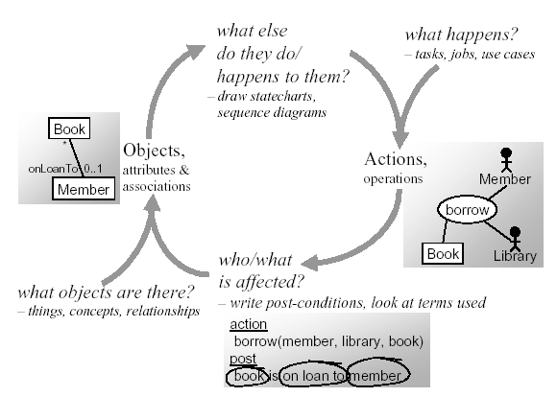
Object Oriented Analysis Flow

Slide 4
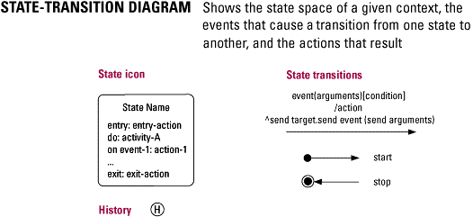
What is State Diagram?
Objects have behaviors and state. The state of an object depends on its current activity and/or condition.
A state diagram shows the possible states of the object and the transitions that cause a change of the state.
Were used prior to UML existence
Use UML State Chart diagram to:
Explore the complex behavior of a single object, actor, subsystem, or component.
Modeling real-time systems.

Slide 5
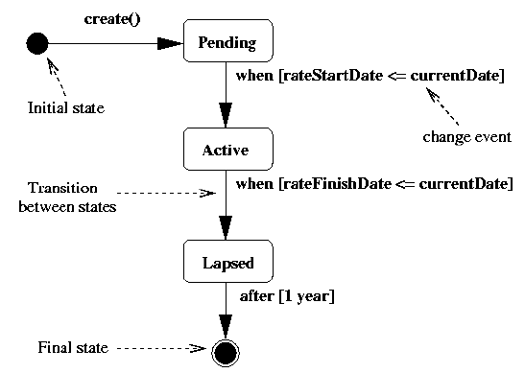
Components of State Diagrams
State of an object
Objects have 1 or more one possible states which are shown as rectangles with rounded corners
An object cannot remain in its initial state and must immediately move into another named state.
Transition from the initial state can be optionally labeled with the event that creates the object.
The final state of an object is shown by a bull's-eye symbol.
State Transition - Movement from one state to another which is triggered by an event.
Transitions are typically the result of the invocation of an operation that causes an important change in state
Not all method invocations will result in transitions.

Slide 6
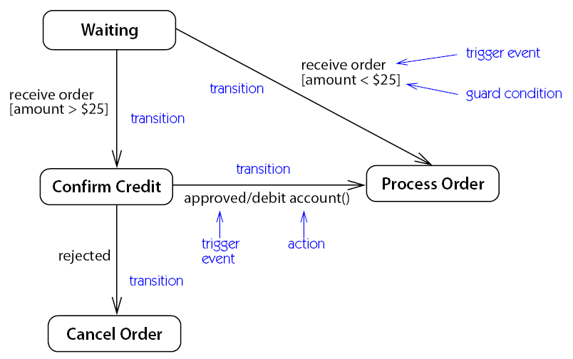
State Diagrams
Shows the lifetime behaviors for a single object [3]

Slide 7
State Diagrams

Slide 8
Transitional label
trigger-signature [guard] / activity
Missing activity: you don’t do anything during the transition
Missing guard: you always take the transition if the event occurs
Missing trigger-signature: rare, take the transition immediately
right-mouse-down (location) [location in window] / object := pick-object (location);
object.highlight ()

Slide 9
Event Types
Triggering Events
When its triggering event occurs a transition is said to fire.
An event is an instance of an event type. It is usually event types that are modeled, but are referred to simply as events.
3 Event Types:
Change event: occurs when a condition (usually Boolean) becomes true.
Annotated by the keyword when followed by the Boolean expression in parenthesis.
This form of conditional event is different from a guard condition that is only evaluated at the moment that it’s associated event fires.
Call event occurs when an object receives a call for one of its operations.
Annotated by the name of the operation as the trigger for the transition
Time event is caused by the passage of a designated period of time after a specified event.
Where the time event reflects the passage of time after entry to the current state, the event is annotated by the keyword after followed by the amount of time in parenthesis.

Slide 10
The process for building a State Diagram
Identify the state that the object is in when it is first created. Model the initial state.
Identify the event(s) that change the object from the initial state to some other state.
Name the new state.
Draw the transition from the first state to the second. Label the transition arrow with the event that triggers the transition.
Identify the action(s) associated with the event and that actually change the object attributes. Add the action after the event name and preceded by a forward slash.
Continue the process with each new event until all events have been accounted for.
If there is a state from which the object can never leave, convert this state to the final state notation.

Slide 11
Tracking Customer Status
We track current customer status to help avoid uncollectable receivables and identify customers worthy of preferred treatment.
All customers are initially set up as prospects, but when they place their first order, they are considered to be active.
If a customer doesn’t pay an invoice on time, he is placed on probation.
If he does pay on time and has ordered more than $10,000 in the previous six months, he warrants preferred status.
Preferred status may be changed only if the customer is late on two or more payments. Then he returns to active status rather than probation, giving him the benefit of the doubt based on his preferred history.

Slide 12
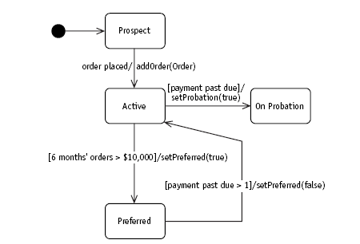
The diagram obtained

Slide 13
Class Activity
A Book object represents all the copies of a certain book in a library system
A Book object is borrowable provided that there is at least one copy on the shelf
The triggers for the state change are borrow and return
Draw a state machine diagram for Book’s life-cycle

Slide 14
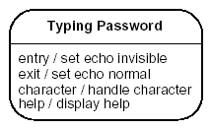
Statechart Diagram: Internal Activities
State transition diagrams are also frequently used for GUI modeling
State may be optionally subdivided into multiple compartments separated from each other by a horizontal line. They are as follows:
Name compartment holds the name of the state as a string.
Internal transitions compartment holds a list of internal actions or activities that are performed while the element is in the state.
Do not trigger any entry/exit transitions but do cause internal activities
Action Label – Circumstances
Acton Expression – Action itself

Slide 15
Activity States
When an object is in a normal state, it is quiet and waiting for an event to happen before it does something
There are states in which object is doing some ongoing work. Such states are called activity states and are marked with do/..
Do-activities unlike the regular actions, can take some time and can be interrupted

Slide 16
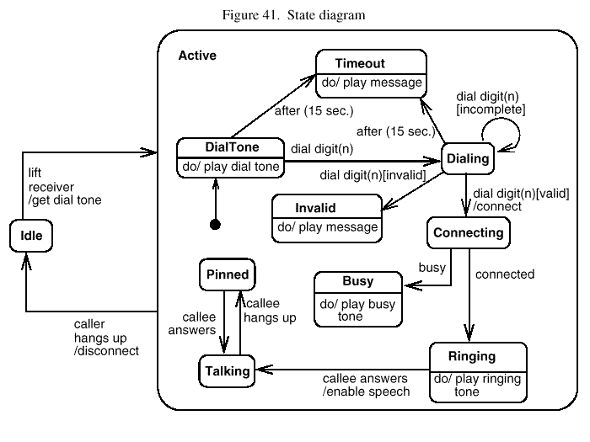
Activity State

Slide 17
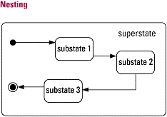
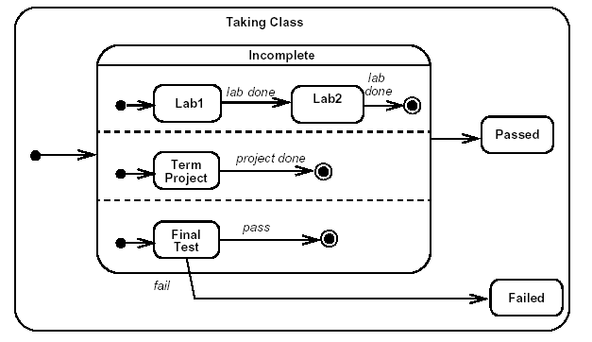
Composite (superstates) and concurrent (orthogonal) states
A composite state is decomposed into two or more sequential/ concurrent sub-states
Modeling sub-states makes sense when the specific existing state exhibits complex behavior.
Introducing a super state makes sense when several existing states share a common entry or exit condition

Slide 18
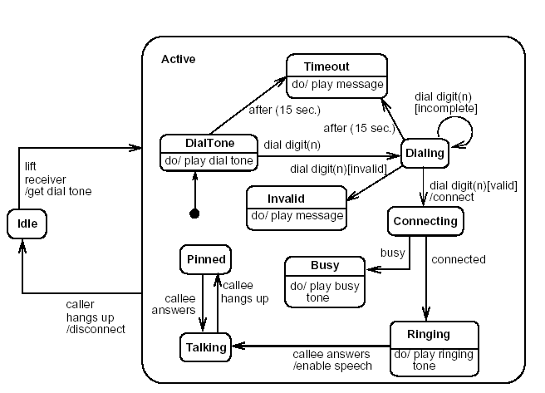
State Chart Diagram for Phone Object

Slide 19
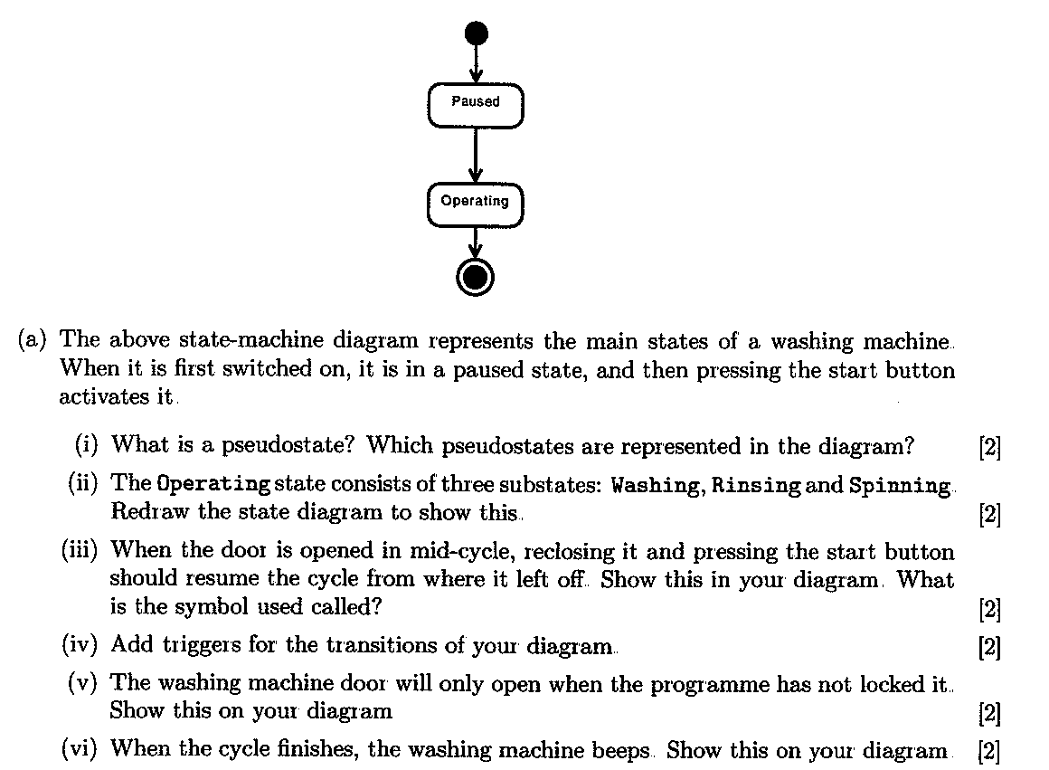
Class Activity

Slide 20
Reference List
[1] Blackwell, T, 2006, Software engineering, algorithm design and analysis: volume 1, p 3, Goldsmiths College, University of London
[2] Fowler M, 2003, UML Distilled. A Brief Guide to Standard Object Modelling Language, Addison Wesley, 3rd edition

Slide 21

End of Lesson
Any questions?

